Slide 1
Review 3 Semester Internship
Project Guide:
Mrs. C. Fancy (Asst. Professor)
Department of Networking and Communications
SRMIST KTR
Student Name: Parivesh Sood
Reg. No.: RA1811029010018
Batch No.: NWC018

Slide 2
Project Title:
The IMAGE CLASSIFICATION USING DEEP LEARNING (DL).

Slide 3
Use Case:
Car Number detection from Number Plate

Slide 4
Abstract
Number plate recognition system is a real time system that automatically detects the number plate from a vehicle and extracts the alphanumeric characters from the number plate, i.e the license number of the vehicle. There are various methods of extracting numbers from the plate. In this paper we have made the use of data processing tools such as morphological transformation, gaussian smoothing/thresholding and edge detection in the pre-processing part. After which for the plate segmentation, contours are used and filtered based on character dimensions and location. At last, I have used Optical Character Recognition to recognize the extracted character data.

Slide 5
Contents:
Introduction
Understanding the problem
Methodology
Proposed Method
Existing Framework for previous research
Scope of this project
Applications
Project Flow
Assumptions

Slide 6
Hardware Requirements
Software Requirements
Required Libraries
Dataset
Challenges and Solutions
Few lines of code
Appendix: Screenshots
Inference from Result
Future Scope
Limitations

Slide 7
Introduction
Car Number Detection from Number Plate aims at detection of the License Plate present on a vehicle and then extracting the contents of that License Plate. A vehicle’s license plate is commonly known as ‘a number plate’. It is a metal plate that is attached to a vehicle and has the official registration number of a vehicle embossed on it. Number plates are placed at the front and back of the vehicle and help anyone to identify a vehicle.

Slide 8
Understanding the problem:
The stated problem can be divided into two sub-problems:
Number Plate Detection. This problem can be tackled using the Object Detection approach where we need to train our model using the car/other vehicle images with number plates.
Extracting text from the detected Number Plate. This problem can be solved using OCR(Optical Character Recognition) which can be helpful in extracting alphanumeric characters from cropped Number Plate images.

Slide 9
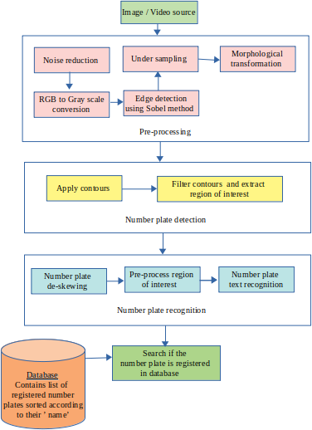
Methodology

Slide 10
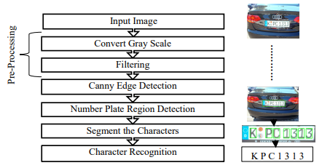
Proposed Method:

Slide 11
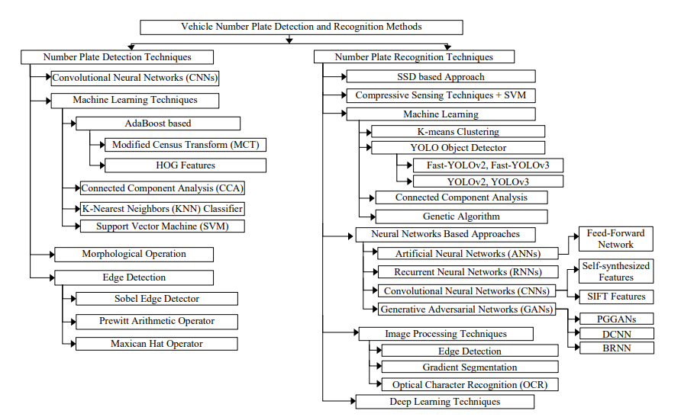
Existing frameworks for previous research:

Slide 12
Scope of this project:
Some places where this solution can be used:
Analysis of city traffic during peak periods
Automation of weigh-in-motion systems
Enhanced vehicle theft prevention
Effective law enforcement
Effective enforcement of traffic rules
Flexible and automatic vehicle entry to and exit from the car park
Management information about car park usage
Improved security for both car park operators and car park users

Slide 13
Applications
Automatic Number Plate Recognition (ANPR) has a wide range of applications since the license number is the primary, most widely accepted, human readable, mandatory identifier of motor vehicles. Some of the applications are:
Housing societies / Apartments: ANPR can be used in housing societies to let in resident’s vehicles inside by storing the number plate details in the database. This can hence reduce the man-force near the security gate. Our project works efficiently in this case provided the society or apartment is not very large.
Parkings: Ticketless parking fee management, parking access automation, vehicle location guidance, parking fee charging, car theft prevention, "lost ticket" fraud, fraud by changing tickets are some areas where ANPR is helpful .

Slide 14
Access Control: License plate recognition brings automation of vehicle access control management, providing increased security, car pool management for logistics, security guide assistance, event logging, event management, keeping access diary, possibilities for analysis and data mining. It is very effective in Border and Law controls too.
Motorway Road Tolling: Tolls are a common way of funding the improvements of highways, motorways, roads and bridges. Efficient road tolling reduces fraud related to non-payment, makes charging effective, reduces required manpower to process events of exceptions and these can be implemented using ANPR.
Journey Time Measurement: Data collected by license plate recognition systems can be used in many ways after processing, feeding back information to road users to increase traffic security, helping efficient law enforcement, optimizing traffic routes and reducing costs and time.

Slide 15
Project Flow:
I have to follow these steps to build my model:
Step 1. Understand the business problem
Step 2. Understand and identify data
Step 3. Collect and prepare data
Step 4. Determine the model's features and train it
Step 5. Evaluate the model's performance and establish benchmarks
Step 6. Put the model in operation and make sure it works well
Step 7. Iterate and adjust the model

Slide 16
Assumptions:
GPU availability for training
Though trained & tested over only Car images, It should be able to detect Number Plates in any sort of vehicle(Bike, Truck, etc)
Image quality is up to mark
No limitation over Memory and Latency
Internet Availability(For OCR purpose)
Python 3+
Videos not considered

Slide 17
Hardware Requirements
A CPU such as i7-7500U that can train with an average of ~115 examples/seconds or any higher specification processor.
A GPU such as Nvidia GTX 1080 (8 GB VRAM) or higher.
At least 8 GB of system RAM or higher.

Slide 18
Software Requirements
Operating system Linux, Unix, Windows 10 or above
Google colab or Jupyter Notebook
Python 3.6 or above

Slide 19
Required libraries
Sys
Glob
os
numpy
cv2
PIL
pytesseract
re

Slide 20
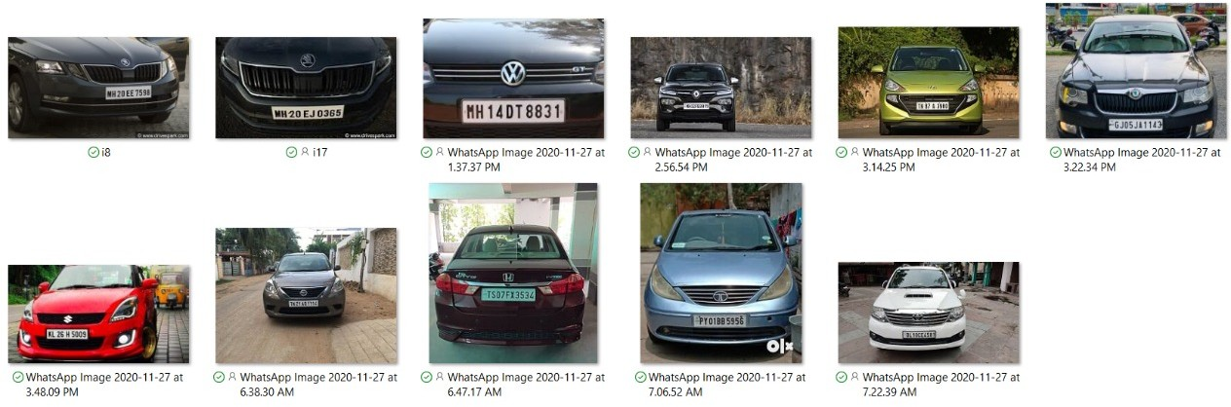
dataset
Images of Indian vehicles where the number plate is clearly visible.

Slide 21
Challenges and solutions
Dealing with bright and dark objects.
Solution: Many details present in an RGB image become less salient when we convert it into grayscale. To visualize the change in intensity and thus to deal with bright and dark objects in the image, converting it to grayscale works best.
Dealing with noisy images.
Solution: We have convolved the image with a Gaussian filter in the pre-processing stage to reduce the noise present in the image.
Dealing with cross-angled or skewed number plates.
Solution: De-skewing, i.e. rotating the image to the required position can be done to detect the text present on the number plate.
Dealing with non-standard number plates.
Solution: The code we implemented won’t give any results in case of non-standard/ partially torn number plates. Hence, they won’t be stored in the database and searching is not possible on it.

Slide 22
Few lines of code: Function for plate detection
def detect_plate(img, text=' '):
plate_img = img.copy()
roi = img.copy()
plate_rect = plate_cascade.detectMultiScale(plate_img, scaleFactor = 1.2, minNeighbors = 7)
#detect the number and finding the x,y,w,h dimensions
for (x,y,w,h) in plate_rect:
roi_ = roi[y:y+h, x:x+w, :]
plate = roi[y:y+h, x:x+w, :]
#drawing rectangles around the edges
cv2.rectangle(plate_img, (x+2,y), (x+w-3, y+h-5), (51,181,155), 3)
if text!='':
plate_img = cv2.putText(plate_img, text, (x-w//2,y-h//2),cv2.FONT_HERSHEY_COMPLEX_SMALL , 0.5, (51,181,155), 1, cv2.LINE_AA)
#returning the processed image
return plate_img, plate

Slide 23
Few lines of code: Character Extraction from input image
# Find characters in the resulting images
def segment_characters(image) :
# Preprocess cropped license plate image
img_lp = cv2.resize(image, (333, 75))
img_gray_lp = cv2.cvtColor(img_lp, cv2.COLOR_BGR2GRAY)
_, img_binary_lp = cv2.threshold(img_gray_lp, 200, 255, cv2.THRESH_BINARY+cv2.THRESH_OTSU)
#applying morphological operations
img_binary_lp = cv2.erode(img_binary_lp, (3,3))
img_binary_lp = cv2.dilate(img_binary_lp, (3,3))
LP_WIDTH = img_binary_lp.shape[0]
LP_HEIGHT = img_binary_lp.shape[1]
# Make borders white
img_binary_lp[0:3,:] = 255

Slide 24
img_binary_lp[:,0:3] = 255
img_binary_lp[72:75,:] = 255
img_binary_lp[:,330:333] = 255
# Estimations of character contours sizes of cropped license plates
dimensions = [LP_WIDTH/6,
LP_WIDTH/2,
LP_HEIGHT/10,
2*LP_HEIGHT/3]
plt.imshow(img_binary_lp, cmap='gray')
plt.show()
cv2.imwrite('contour.jpg',img_binary_lp)
# Get contours within cropped license plate
char_list = find_contours(dimensions, img_binary_lp)
return char_list

Slide 25
Few lines of code: Model Creation
#providing the input training and validation data
train_datagen = ImageDataGenerator(rescale=1./255, width_shift_range=0.1, height_shift_range=0.1)
path = "data"
train_generator = train_datagen.flow_from_directory(
path+'/data/train', # this is the target directory
target_size=(28,28), # all images will be resized to 28x28
batch_size=1,
class_mode='sparse')
validation_generator = train_datagen.flow_from_directory(
path+'/data/val', # this is the target directory
target_size=(28,28), # all images will be resized to 28x28 batch_size=1,
class_mode='sparse')

Slide 26
K.clear_session()
#creating sequential model
model = Sequential()
#creating convolutional kernal convolves with input or previus layer
model.add(Conv2D(8, (22,22), input_shape=(28, 28, 3), activation='relu', padding='same'))
model.add(Conv2D(16, (8,8), input_shape=(28, 28, 3), activation='relu', padding='same'))
model.add(Conv2D(32, (4,4), input_shape=(28, 28, 3), activation='relu', padding='same'))
model.add(Conv2D(32, (4,4), input_shape=(28, 28, 3), activation='relu', padding='same'))
#Downsamples the input
model.add(MaxPooling2D(pool_size=(4, 4)))
model.add(Dropout(0.4))
#Flattening the input
model.add(Flatten())
model.add(Dense(128, activation='relu'))
model.add(Dense(36, activation='softmax'))
#defining the parameters
model.compile(loss='sparse_categorical_crossentropy', optimizer=optimizers.Adam(learning_rate=0.0001), metrics=[custom_f1score])
model.summary()

Slide 27
class stop_training_callback(tf.keras.callbacks.Callback):
def on_epoch_end(self, epoch, logs={}):
if(logs.get('val_custom_f1score') > 0.99):
self.model.stop_training = True
batch_size = 1
callbacks = [stop_training_callback()]
history = model.fit(
train_generator,
steps_per_epoch = train_generator.samples // batch_size,
validation_data = validation_generator,
epochs = 50, verbose=1, callbacks=callbacks)

Slide 28
Few lines of code: Final predicted output
def fix_dimension(img):
new_img = np.zeros((28,28,3))
for i in range(3):
new_img[:,:,i] = img
return new_img
def show_results():
dic = {}
characters = '0123456789ABCDEFGHIJKLMNOPQRSTUVWXYZ'
for i,c in enumerate(characters):
dic[i] = c
output = []

Slide 29
for i,ch in enumerate(char): #iterating over the characters
img_ = cv2.resize(ch, (28,28), interpolation=cv2.INTER_AREA)
img = fix_dimension(img_)
img = img.reshape(1,28,28,3) #preparing image for the model
y_ = model.predict(img)[0]
y_ = np.argmax(y_)
#y_ = model.predict_classes(img)[0] #predicting the class
character = dic[y_] #
output.append(character) #storing the result in a list
plate_number = ''.join(output)
return plate_number

Slide 30
print(show_results())
# Segmented characters and their predicted value.
plt.figure(figsize=(10,6))
for i,ch in enumerate(char):
img = cv2.resize(ch, (28,28), interpolation=cv2.INTER_AREA)
plt.subplot(3,4,i+1)
plt.imshow(img,cmap='gray')
plt.title(f'predicted: {show_results()[i]}')
plt.axis('off')
plt.show()

Slide 31
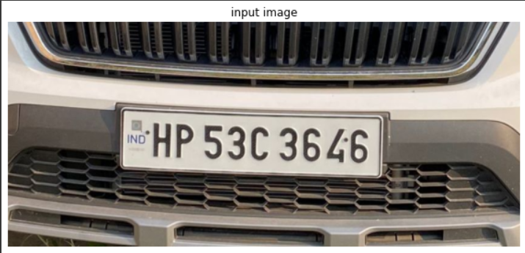
Appendix : Screenshots Input Image

Slide 32
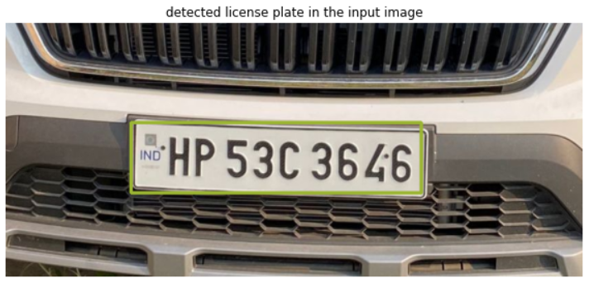
Appendix : Screenshots Detected license plate

Slide 33
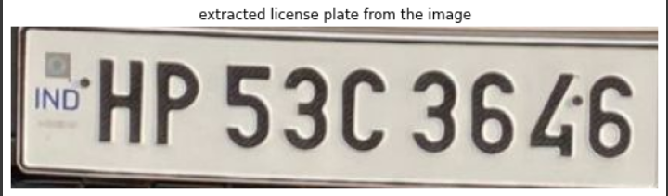
Appendix : Screenshots Extracted license plate

Slide 34
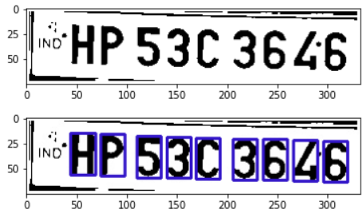
Appendix : Screenshots Detected characters from the plate

Slide 35
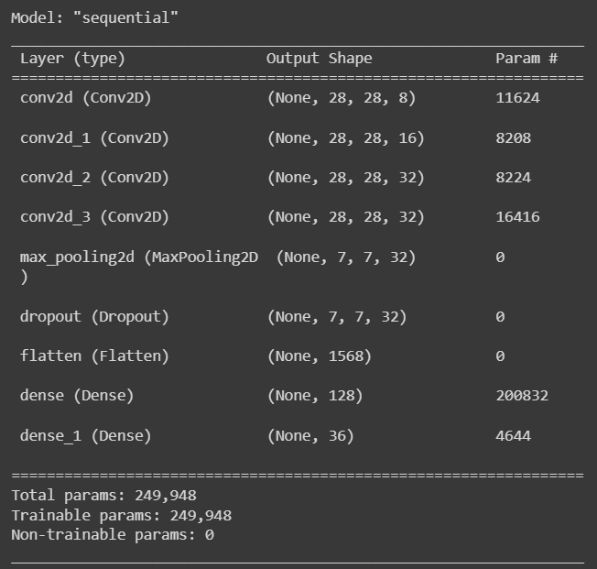
Appendix: Screenshots Model details

Slide 36
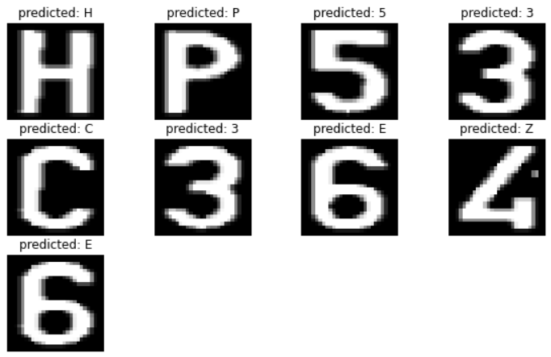
Appendix: Screenshots Segmented result with predicted value

Slide 37
Inference from result
Presented here is the process-oriented approach ensures a better way for refining the software architecture of the ANPR system by mapping efficiently the CSP processes to corresponding OS tasks and threads. The developed on the base of this approach ANPR system is flexible and can be easily extended or reduced for different goals - speed control, traffic control, highway tolling, lots control, etc. by adding or discarding some processes or threads, using simple configuration files. In the future the ANPR system will be extended with additional module (OS process) responsible for on-line self-update of the OS and other ANPR processes which will decrease dramatically the time for maintenance.

Slide 38
Future Scope
The future scope is that the automatic vehicle recognition system plays a major role in detecting threats to defense Also it can improve the security related to the women’s as they can easily detect the number plate before using cab or other services. The system robustness can be increase if bright and sharp camera is used. Government should take some interest in developing this system as this system is money-saving and eco- friendly, if applied effectively in various areas...

Slide 39
Limitations
In some cases, bad weather and hindrances can make automatic license plate recognition systems not completely effective. When this happens the security measures might be turned off and manned surveillance will be more needed.
The fact that images and records are kept and stored raises some privacy concerns. People are usually afraid that the records of someone’s whereabouts in all these footages might be misused. It can become a subject of data thefts or people with all kinds of nefarious intentions.

Slide 40
Thank You

